Slide 1
Data structures and its types

Slide 2
Agenda
What is data structure?
Types of data structures

Slide 3
What is data structure?
Definition: Data Structure is a way of organizing data in a specific order as required for better understanding and rapid execution of operations on the data.
Data is nothing but groups of numbers or texts which makes their existence meaningful.
Data can be structured/arranged in different ways as per the requirement.

Slide 4
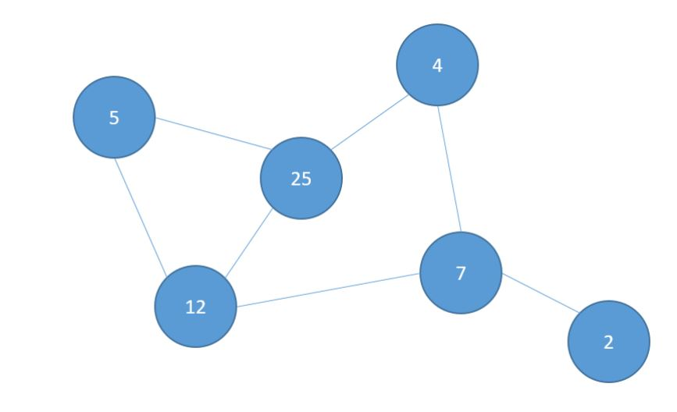


Types of data structures
Data Structure
Non-Linear Data Structure
Linear Data Structure
A
B
C
D
E

Slide 5
Summary
We have seen what data structure is and its types.

Slide 6
Thank You
Proprietary content. ©Great Learning. All Rights Reserved. Unauthorized use or distribution prohibited

